Slide 1

WNE UW
Monopoly - Dynamic Pricing (early draft)
Notes:
1

Slide 2
Fundamental Concepts
The monopoly is defined as a single supplier but except for some rare example of government or natural monopolies, we can face with monopoly power not exactly with the monopoly.
The power of the monopoly depends mainly on market evolution or institutional settings.

Slide 3
Fundamental Concepts (chat gpt and my old work)
Sources of Monopoly Power:
Government-Mandated Monopoly
Examples include the exclusive right to print money, enforced by legal authority.
Often arises from government intervention, such as licensing, regulation, or direct control over specific industries. This type of monopoly can serve as a tool for economic stability or public policy but may lead to inefficiencies and lack of competition. However, the relationship between the government and the market can give rise to rent-seeking behavior, where individuals or organizations expend resources to secure exclusive privileges or advantages granted by the state, rather than contributing to productive economic activities. Rent-seeking can manifest in lobbying efforts to secure government-sanctioned monopolies, protective tariffs, or favorable regulations, which distort market outcomes and lead to a misallocation of resources. The concept of rent-seeking is brilliantly explored in Gordon Tullock's seminal 1966 article, "The Welfare Costs of Tariffs, Monopolies, and Theft", which remains highly relevant today. https://devf21.classes.ryansafner.com/readings/Tullock-1967.pdf

Slide 4
Fundamental Concepts (chat gpt and my old work)
Patents
Intellectual property rights granting exclusivity to inventors or companies for a limited time. Encourage innovation by protecting the creator's investment. However, patents can also create temporary monopolies, potentially limiting access to essential goods or technologies. However, patents can also create temporary monopolies, potentially limiting access to essential goods or technologies, especially in industries such as healthcare or technology.
A notable consequence of the patent system is the emergence of patent wars, where companies aggressively use their patent portfolios as strategic weapons. Patent wars often involve suing competitors for infringement, filing defensive patents to block others, or acquiring large portfolios to strengthen market position. These conflicts are particularly prevalent in industries such as pharmaceuticals, software, and telecommunications, where innovation is rapid and patents play a central role in competition. While patents are intended to foster innovation, patent wars can lead to significant costs, such as:
Legal expenses: Companies may spend billions on litigation rather than on research and development.
Market delays: Products or technologies may be withheld from the market due to disputes over intellectual property rights.
Patent trolling: Non-practicing entities (NPEs) or "patent trolls" acquire patents solely to extract licensing fees or settlements without contributing to innovation.

Slide 5
Fundamental Concepts (chat gpt and my old work)
Exclusive Ownership of Resources or Infrastructure
Control over scarce resources (e.g., minerals, energy sources) or critical infrastructure (e.g., railroads, ports). This exclusivity often prevents competitors from entering the market. Historically, such monopolies have influenced markets and economies on a global scale. In less-developed countries and post-socialist economies, the privatization of natural resources during economic transitions frequently led to their concentration in the hands of a small, powerful elite oligarchy. In post-socialist states, such as Russia or Ukraine, privatization programs in the 1990s resulted in the rise of oligarchs who gained control over vast natural resources and critical infrastructure (e.g., oil, gas, and mining). In less-developed economies, international corporations or domestic elites often exploit weak institutions to secure exclusive access to natural resources, further entrenching inequality and slowing economic progress.
This phenomenon reflects the resource curse paradox, where countries rich in natural resources often experience slower economic growth, weaker democratic institutions, and higher poverty levels due to corruption, rent-seeking, and reliance on resource exports at the expense of diversified development.

Slide 6
Fundamental Concepts (chat gpt and my old work)
Monopoly as a Natural Consequence of Competition
Over time, intense competition can drive weaker firms out of the market, leaving only the strongest players. The most efficient or innovative company may dominate, gaining significant market power and eventually establishing a monopoly. This phenomenon is especially common in industries with high network effects (e.g., social media, e-commerce platforms) or economies of scale. For example, companies like Meta (formerly Facebook) and Google have leveraged network effects to consolidate their dominance, as their platforms become more valuable the more users they attract. These firms often use their market position to acquire potential competitors or integrate new services, further entrenching their dominance. While it reflects the survival of the fittest, such monopolistic tendencies may reduce consumer choice, limit competition, and stifle innovation by discouraging new entrants from challenging the status quo. This dynamic raises important questions about the role of regulation and antitrust enforcement in fostering a balanced, competitive marketplace.

Slide 7
Fundamental Concepts (chat gpt and my old work)
Formation of Cartels
Agreements between companies to control prices, production, or market shares, effectively monopolizing the market. Reduces competition and leads to higher prices for consumers. Cartels are typically illegal but can persist in less regulated markets or through tacit collusion.

Slide 8
Fundamental Concepts (chat gpt and my old work)
Natural Monopoly !!!!
A natural monopoly occurs in industries with high fixed costs and significant economies of scale, where a single provider can operate more efficiently than multiple competitors. This is common in sectors like water supply, electricity, and telecommunications. Historically, telecommunications, such as fixed-line telephony, required vast infrastructure investments, leading to national operators dominating the market. However, technology is transforming these dynamics in two ways. On one hand, advancements can reduce barriers, as seen in telecommunications, where competition emerged with mobile networks and internet-based communication. On the other hand, modern industries like AI show the opposite trend, where developing and training large-scale models demands immense resources for data acquisition and processing, reinforcing monopolistic tendencies. Nevertheless, similar to the historical evolution in telecommunications, one can expect that technological advancements and regulatory changes might eventually lead to more competition in AI-driven markets.

Slide 9

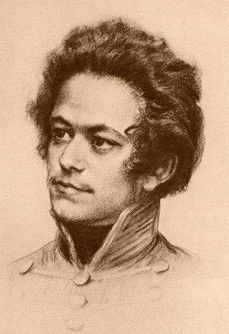
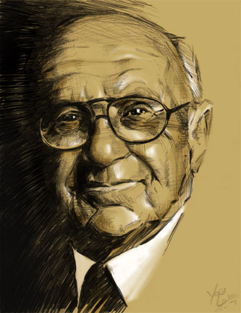
We do not address the question:
What should prices be?
Thomas Aquinas: Prices should reflect fairness, rooted in moral and ethical considerations, ensuring justice in exchanges.
Milton Friedman: Prices should be determined by free market forces, reflecting supply and demand without government interference.
Karl Marx: Prices should ultimately align with the labor theory of value, as determined by the amount of socially necessary labor time required to produce goods.
Thomas Aquinas
Karl Marx
Milton Friedman
Today, we will focus on how prices are actually set by firms using monopoly power—specifically through dynamic pricing.

Slide 10
How Do Firms Set Prices? Answer 1
The market sets the prices, and firms adjust to them.
The classical answer is that the market sets prices, and firms adjust to them. In a perfectly competitive market, firms act as price-takers with no influence over prices. This requires many small, identical firms, homogeneous products, and perfect information, ….
However, this idealized scenario is rarely realistic—even at local markets or bazaars. In practice, firms often have some degree of pricing power due to factors such as imperfect information, product differentiation, or local market conditions.

Slide 11
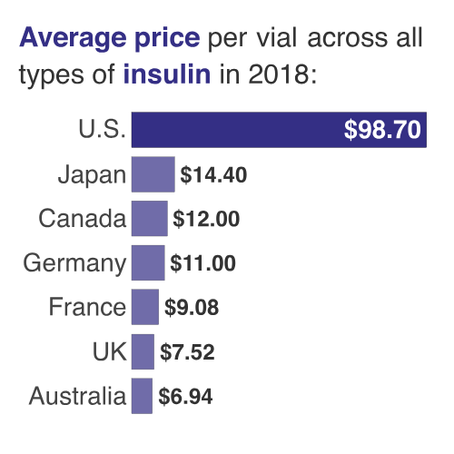
How Do Firms Set Prices? Answer 1:
The main „old” (forget about the patent rights) antipsychotic drug Clozapine → the regional pricing comparison.
In theory, competition enforces the law of one price: identical goods sold in different locations should have the same price. In reality, transaction costs, such as transportation, tariffs, and local regulations, lead to price disparities.
For example, the price of the same „old” drugs varies widely across countries due to differences in healthcare systems, subsidies, and distribution markups. These factors highlight how transaction costs disrupt the ideal of uniform pricing, even for identical products. The price can vary significantly depending on characteristic of the market and institutional settings.
Why such big differences?
(In Poland, the drug is refunded but full price (100%) is 23,80 zł ($5,62)

Slide 12
How Do Firms Set Prices?
The American medicine market is not competitive and it is corrupted in name of free market and competition. Read:
https://www.vox.com/a/health-prices
https://berniesanders.com/issues/fighting-to-lower-prescription-drug-prices/
And there are some externalities of medicine marketing. The main dealer of "drugs" is a pharmacy company: ........
https://www.theguardian.com/us-news/2017/oct/25/americas-opioid-crisis-how-prescription-drugs-sparked-a-national-trauma

Slide 13
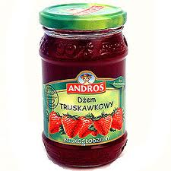



How Do Firms Set Prices? Answer 2
A firm calculates product prices based on costs, e.g., cost + 10%.
The price must exceed costs in the long run, as this is the only certainty in price calculation.
…. However, the traditional cost-plus pricing approach is becoming less relevant. For example, "cheap" and premium brands may have nearly identical production costs, but their pricing differs drastically due to perceived quality, branding, and market positioning.
Pricing strategies now rely more on customer value perception and competitive dynamics than on fixed cost margins.
Cheap brands vs. premium brands
Intentional quality degradation

Slide 14
How Do Firms Set Prices? Answer 3
New environment of markets:
  - globalisation
  - electronic transactions
  - the weakness of governments (lobbying)
creates new opportunities to create firms’ market monopoly power.
You should get to know the new environment of competition and its old/new tools.

Slide 15
How Do Firms Set Prices? Answer 3
We can use the data (experuiment pens and mugs valuation) to show some pricing strategies :
Monopoly / perfect competition (as a benchmark)
First-degree, second-degree, and third-degree price discrimination
Two-part tariff
Bundling
Auctions
…
Based on the data you can find the best pricing strategy at the lecture (it is your further work as a data scientist)

Slide 16
Fundamental Concepts: Monopoly
In its simplest textbook form, a monopoly is a single seller (producer) in the market. The monopolist knows the market demand for its products and sets prices based on the relationship between price and output, as determined by the demand curve D=p(Y).
This basic model assumes no inventory buildup and no speculation over time. It represents the most straightforward framework for understanding monopoly behaviour, focusing only on the immediate price-output decision without introducing complexities like storage or dynamic adjustments over time. This foundational approach provides a starting point for more advanced analyses of monopoly strategies.

Slide 17
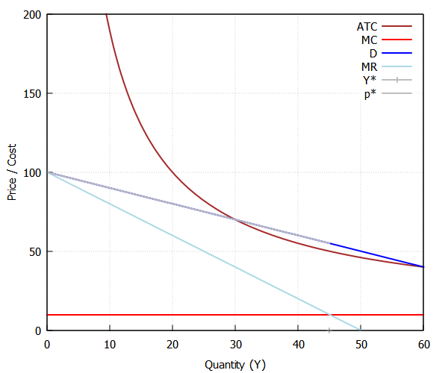
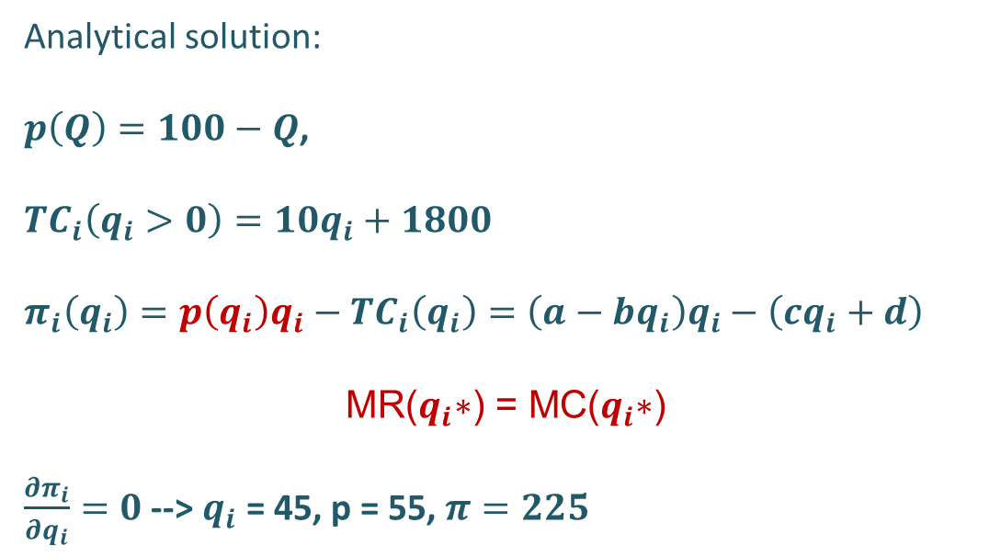
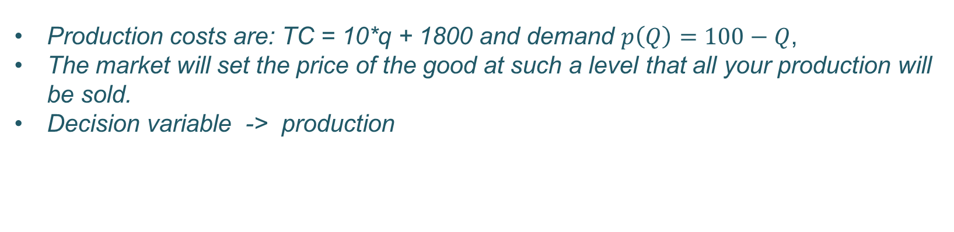
Fundamental Concepts: Monopoly
Production costs are: TC = 10*q + 1800 and demand $p\left(Q\right)=100−Q$,
The market will set the price of the good at such a level that all your production will be sold.
Decision variable -> production
By trials and errors, the firm is able to find the optimal solution.
Analytical solution:
$p\left(Q\right)=100−Q$,
${TC}_{i}\left(q_{i}>0\right)=10q_{i}+1800$
$$π_{i}\left(q_{i}\right)=p\left(q_{i}\right)q_{i}−{TC}_{i}\left(q_{i}\right)=\left(a−bq_{i}\right)q_{i}−\left(cq_{i}+d\right)$$
$$\text{MR}\text{(}q_{i}\text{∗) = }\text{MC}\text{(}q_{i}\text{∗)}$$
$\frac{∂π_{i}}{∂q_{i}}=0$ --> $q_{i}$ = 45, p = 55, $π=225$

Slide 18
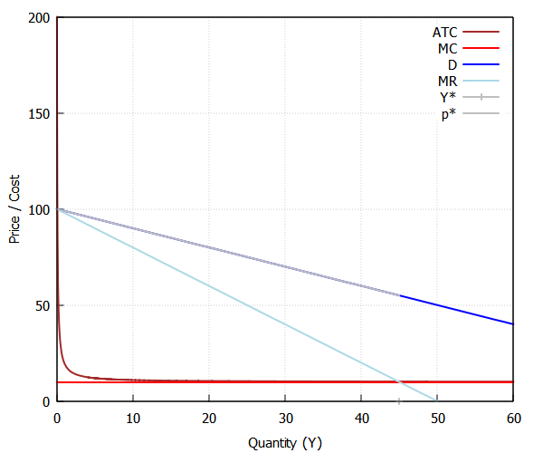
Fundamental Concepts: Monopoly
kill(all)$ /* Clear all previous variables and load required packages */
load(draw)$
/* Assumptions for variables */
assume(X1 > 0, X2 > 0, w1 > 0, w2 > 0, Y > 0)$
/* Cost functions */
FC: 1800$ /* Fixed costs */
VC: 10 * Y$ /* Variable costs */
TC: ''(VC + FC)$ /* Total costs */
MC: diff(TC, Y, 1)$ /* Marginal cost */
ATC: TC / Y$ /* Average total cost */
/* Inverse demand function */
eq_demand: Y = 100 - p_D$ /* Demand equation */
solve([eq_demand], [p_D])$
p_D: rhs(%[1])$ /* Extracting price as a function of Y */
/* Revenue and marginal revenue */
R: ratsimp(p_D * Y)$ /* Total revenue */
MR: diff(R, Y, 1)$ /* Marginal revenue */
/* Equilibrium: MR = MC */
eq_equilibrium: MR = MC$ /* Equilibrium condition */
solve([eq_equilibrium], [Y])$
Y_star: rhs(%[1])$ /* Equilibrium quantity */
Y_star: float(Y_star)$ /* Convert to floating-point */
p_star: ''p_D$ /* Equilibrium price */
p_star: float(p_star)$ /* Convert to floating-point */
/* Total cost, revenue, and profit at equilibrium */
TC_star: ''TC$
TC_star: float(TC_star)$
R_star: ''R$
R_star: float(R_star)$
Profit: R_star - TC_star$ /* Profit */
Profit: float(Profit)$
/* Rationalize values for plotting */
p_star: rationalize(p_star)$
Y_star: rationalize(Y_star)$
MC: rationalize(MC)$
/* Plotting */
Y_max_rys: 60$ /* Maximum quantity for the plot */
draw2d(
grid = true,
xlabel = "Quantity (Y)",
ylabel = "Price / Cost",
line_width = 2,
yrange = [0, 200],
/* Average total cost curve */
color = brown, key = "ATC", explicit(ATC, Y, 0, Y_max_rys),
/* Marginal cost curve */
color = red, key = "MC", explicit(MC, Y, 0, Y_max_rys),
/* Demand curve */
color = blue, key = "D", explicit(p_D, Y, 0, Y_max_rys),
/* Marginal revenue curve */
color = light_blue, key = "MR", explicit(MR, Y, 0, Y_max_rys),
/* Equilibrium quantity and price */
color = grey, key = "Y*", points_joined = true, points([[Y_star, 0], [Y_star, p_star]]),
color = grey, key = "p*", explicit(p_star, Y, 0, Y_star) )$
Y: rationalize(Y_star)$
/* Print equilibrium conditions */
print("Equilibrium Conditions:")$
print("Price (p*):", ''p_star)$
print("Quantity (Y*):", ''Y_star)$
print("Total Cost (TC):", ''TC_star)$
print("Total Revenue (R):", ''R_star)$
print("Profit:", ''Profit)$
This is an example of a natural monopoly due to high fixed costs (FC =1800). Only the monopolist's production can cover the average costs, as the price exceeds the average cost (P>ATC). When the fixed cost approaches zero (FC→0), the average cost starts to converge with the marginal cost (ATC≈MC). Going forward, we will use the approximation MC=ATC.
FC = 1800
"Average total cost:"" "50" "
FC = 20
"Average total cost:"" „10.4" ~ MC
Only one large firm can achieve profits due to technological reasons → Natural Monopoly.

Slide 19
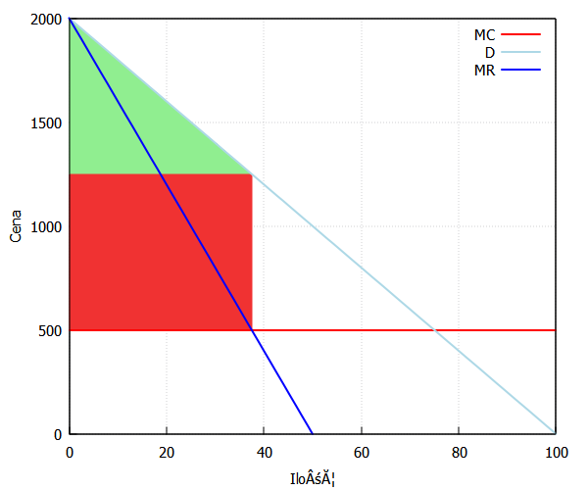
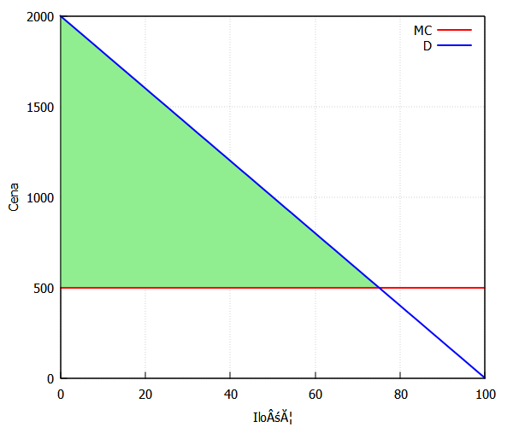
Fundamental Concepts: Monopoly
 | Perfect commpetition | Monopoly | Change
Consuments | a +b + c | a | -b-c
Producers | d + e | e+ b | b-d
Sum | c +e | a+b+e | -c-d
p(Y)
The existence of a monopoly leads to a deadweight social loss (c+d) → inefficiency.
a
p(Y^{M})
b
c
MC(Y) → supply
p(Y^{PK})
d
e
Y^{M}
Y^{PK}
Y
MR(Y)

Slide 20
Fundamental Concepts: Monopoly wants more
On the left, the "classical monopoly" maximizes profits by setting a price above marginal cost, capturing part of the consumer surplus as profit.
P
Cena
P
cena
On the right, the monopoly fully exploits demand by capturing the entire consumer surplus. This approach relies on knowing the consumers' Willingness to Pay (WTP) and turning it entirely into profit.
Profit
Profit
MR
D
D
Q
Q*
Q*

Slide 21
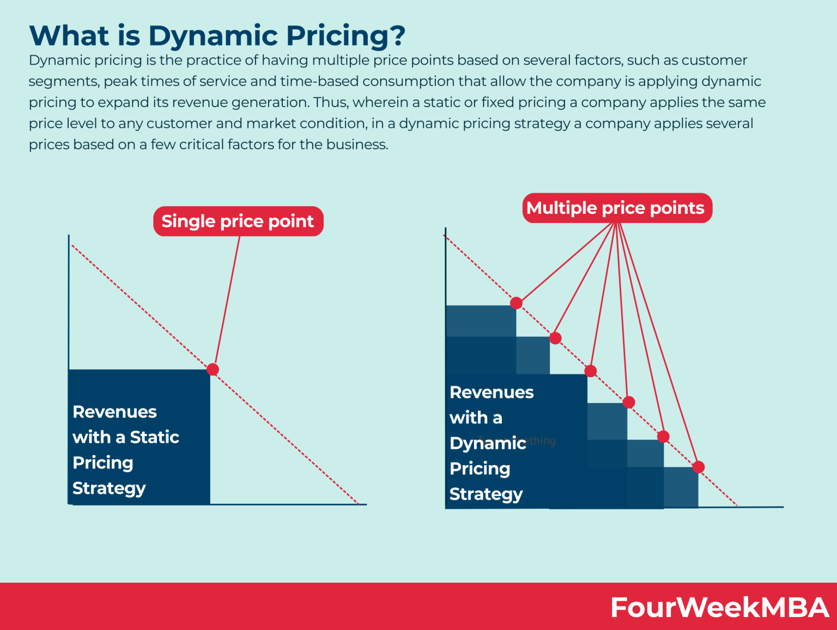
Fundamental Concepts: Monopoly wants more
The entire dynamic pricing framework revolves around capturing consumer surplus and converting it into monopolistic profit. Through perfect price discrimination, a monopoly ensures that consumers do not benefit beyond their individual Willingness to Pay (WTP).
Data analysis enables dynamic adaptation to changing market conditions and allows the use of tools that were previously impossible to implement due to consumer heterogeneity and lack of information about their preferences.
Compare the earlier slide on our microeconomic approach with the graphic from a detailed resource describing these techniques—be sure to visit that site:
https://fourweekmba.com/dynamic-pricing/#When_price_tags_didnt_even_exist
While effective, dynamic pricing raises ethical concerns if it is perceived as discriminatory or exploitative, particularly when customers feel penalized for urgent needs or limited alternatives.
D

Slide 22
First-Degree Price Discrimination
(Perfect Price Discrimination) Benchmark
The monopolist has complete information about each consumer's Willingness to Pay (WTP).
Each consumer pays their reservation price, which is the maximum amount they are willing to pay for a product.
This eliminates consumer surplus entirely, converting it fully into monopolistic profit.
Although this practice is effectively banned in most traditional markets due to legal and ethical considerations, it is increasingly prevalent in e-commerce, where vast amounts of data allow firms to analyze individual purchasing behavior. Online retailers can track browsing history, purchasing habits, and even device usage to tailor prices dynamically to each consumer.
In e-commerce, companies try to implement first-degree price discrimination through personalized pricing algorithms. For example:
A consumer who frequently searches for flights may see higher ticket prices than a less active user.
Customers using premium devices (e.g., MacBooks) might receive higher price offers, assuming their purchasing power is greater.
p
Profit
400
300
200
D(q)
MC = ATC
Costs
D

Slide 23
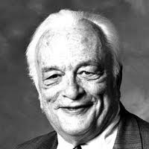
Mechanism Design
Second-Price Auction (Vickrey Auction)
Winning strategy: Bid equal to your private valuation b=v, revealing your true willingness to pay (WTP).
Key Features:
Increases the likelihood of winning without overpaying.
Does not impact profit: The winning bid pays the second-highest bid, so the profit is determined by the difference between the winner's private valuation and the second-highest bid.
300
b ₃
v₃
b ₁
P
v₁
  William Vickrey
  (1914-1996)
b ₂
v₂
100
D

Slide 24
Second -Degree Price Discrimination
(Price depends on the quantity purchased)
The price is determined by the quantity of the good purchased.
Larger quantities are often offered at lower unit prices, encouraging higher consumption.
This type of price discrimination is common in scenarios where the seller cannot perfectly distinguish between consumers' willingness to pay but can offer pricing tiers based on consumption levels. Examples include bulk discounts, tiered pricing in utilities, or subscription models with volume-based pricing.
Buy 2, Get 1 Free This is an example of second-degree price discrimination, where the price per unit decreases as the quantity purchased increases. The consumer pays for two items but receives three, effectively lowering the average price per item. Supermarkets or retail stores often use this strategy for products like snacks, drinks, or personal care items to increase sales volume.
Wholesale and Retail Prices This is another form of second-degree price discrimination, where different prices are set for customers based on the quantity they purchase.
P
300
200
D(Q)
costs
Q

Slide 25
Second -Degree Price Discrimination
(Price depends on the quantity purchased)
/* Clear all previous variables */
kill(all)$
/* Firm's characteristics */
MC: 50$ /* Marginal cost */
ATC: MC$ /* Average total cost */
demand: Y = 1000 - p$ /* Demand function */
solve([demand], [p])$
p: rhs(%[1])$ /* Price as a function of quantity */
/* Pricing Scheme A: Price change thresholds at Y = 50 and Y = 200 */
Y: 50$ /* First threshold for Scheme A */
y1: Y$
p_A1: float(ev(''p))$ /* Price for Y = 50 */
R_A1: float(Y * p_A1)$ /* Revenue for first segment */
TC_A1: float(Y * MC)$ /* Total cost for first segment */
Y: 200$ /* Second threshold for Scheme A */
y2: Y$
p_A2: float(ev(''p))$ /* Price for Y = 200 */
R_A2: float((y2 - y1) * p_A2)$ /* Revenue for second segment */
TC_A2: float((y2 - y1) * MC)$ /* Total cost for second segment */
TC_A: TC_A1 + TC_A2$ /* Total cost for Scheme A */
Profit_A: float(R_A1 + R_A2 - TC_A)$ /* Profit for Scheme A */
/* Pricing Scheme B: Price change thresholds at Y = 100 and Y = 300 */
Y: 100$ /* First threshold for Scheme B */
y3: Y$
p_B1: float(ev(''p))$ /* Price for Y = 100 */
R_B1: float(Y * p_B1)$ /* Revenue for first segment */
TC_B1: float(Y * MC)$ /* Total cost for first segment */
Y: 300$ /* Second threshold for Scheme B */
y4: Y$
p_B2: float(ev(''p))$ /* Price for Y = 300 */
R_B2: float((y4 - y3) * p_B2)$ /* Revenue for second segment */
TC_B2: float((y4 - y3) * MC)$ /* Total cost for second segment */
TC_B: TC_B1 + TC_B2$ /* Total cost for Scheme B */
Profit_B: float(R_B1 + R_B2 - TC_B)$ /* Profit for Scheme B */
/* First-Degree Price Discrimination */
kill(Y)$
eq: ''p = MC$ /* Equilibrium condition: price = marginal cost */
solve([eq], [Y])$
Y: rhs(%[1])$
Y_star: Y$ /* Equilibrium quantity */
TC_FD: float(Y_star * MC)$ /* Total cost for first-degree discrimination */
kill(Y)$
R_FD: float(integrate(1000 - Y, Y, 0, Y_star))$ /* Total revenue */
Profit_FD: float(R_FD - TC_FD)$ /* Profit under first-degree discrimination */
/* Display results */
print("Pricing Scheme A:")$
print("Price for Y = 50:", p_A1)$
print("Price for Y = 200:", p_A2)$
print("Profit (Scheme A):", Profit_A)$
print("Pricing Scheme B:")$
print("Price for Y = 100:", p_B1)$
print("Price for Y = 300:", p_B2)$
print("Profit (Scheme B):", Profit_B)$
print("First-Degree Price Discrimination:")$
print("Profit (First-Degree):", Profit_FD)$
Exam Task
A monopolist wants to increase profits by introducing price discrimination based on quantity. The firm considers two pricing schemes:
Price change thresholds at Y=50 and Y=200Y
Price change thresholds at Y=100 and Y=300.
Firm's characteristics: MC=ATC=50; Demand function: Y=1000−p
Questions: Is there a better way to implement price discrimination than the proposed schemes? This can be done by substituting different values or solving analytically. What is the profit under first-degree price discrimination and simply monpoly?
(this example from the exam task is somewhat artificial)
I didn't manage to test the procedure "buy two, get the third one free" on data from your "market" experiment.
"Pricing Scheme A:"" "
"Price for Y = 50:"" "950.0" "
"Price for Y = 200:"" "800.0" "
"Profit (Scheme A):"" "157500.0" "
"Pricing Scheme B:"" "
"Price for Y = 100:"" "900.0" "
"Price for Y = 300:"" "700.0" "
"Profit (Scheme B):"" "215000.0" "
"First-Degree Price Discrimination:"" "
"Profit (First-Degree):"" "451250.0" "

Slide 26
Third-Degree Price Discrimination
(dividing consumers into distinct groups)
Third-degree price discrimination involves segmenting consumers into separated groups based on their willingness to pay (reflected in the demand curve as elasticity) and charging different prices to each group. This strategy enables monopolists to capture a portion of the total surplus.
The most intriguing aspect is finding a self-selection mechanism that differentiates consumers into two or more groups with different demand function characteristics. Consumers, through their consumption patterns of goods or services, naturally segregate themselves.
p
profit
profit
cost
cost
q

Slide 27

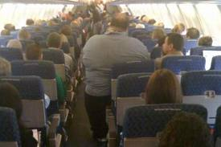
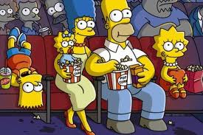
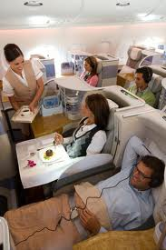
Third-Degree Price Discrimination
(dividing consumers into distinct groups)
p
Cinema Tuesday morning
p
People who clip coupons often have more free time and are highly price-sensitive, seeking to maximize their savings by spending effort. On the other hand, consumers who do not use coupons typically value their time more, are less sensitive to price, and are willing to pay higher prices for convenience.
Traditional airlines had economy class, which was price-sensitive, and business class, which was less so. If someone was flying during the week, they had to buy a business class ticket. Businesspeople wanted to return home for the weekend, and it wasn't them paying.
If you go to the movies on a Tuesday morning, you can expect that the people who come will have time and not a lot of money - meaning the demand is elastic, sensitive to price changes, so the price should be low. On Saturday evening, the price is high because the demand is inelastic.
Economy class
q
Saturday evening
p
business class

Slide 28
Third-Degree Price Discrimination
(dividing consumers into distinct groups)
I haven't dealt with these topics for almost five years. What I used to present were self-selection models, where time played a significant role. For instance:
If you wanted to wear something fashionable, you'd pay a high price, but the same item would be sold at cost in two months.
During a crisis, you'd launch a cheap brand; in times of prosperity, you'd sell the same product as a premium brand.
Now, I see these models shifting toward what could be called forced selection models. Prices can change dynamically, sometimes within a few minutes, and consumers have no choice but to buy or not buy.

Slide 29
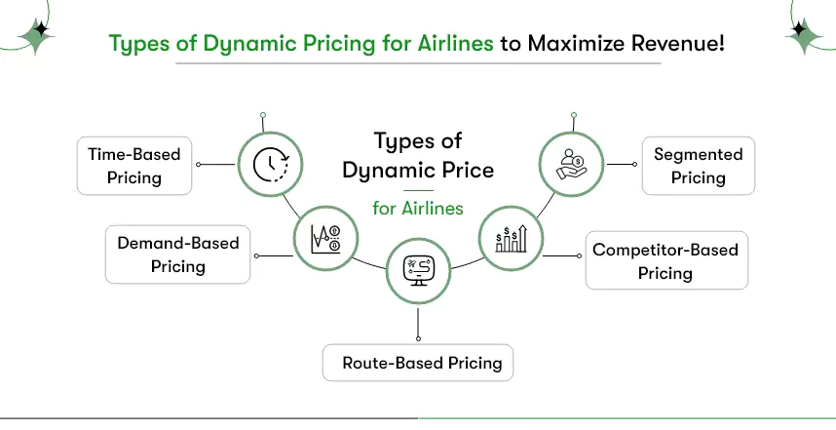
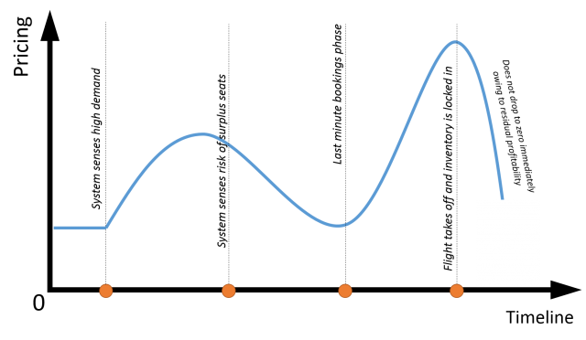
Third-Degree Price Discrimination
(dividing consumers into distinct groups)
It shift from self-selection to forced selection has fundamentally changed how pricing works. Time is no longer a predictable factor; consumers must act immediately or risk paying more- they are playing with your risk attitude.
Airline Ticket Prices:
In the past: There were fixed prices—business class and economy class.
More recently: At the beginning of sales, prices started low and increased steadily as the departure date approached, allowing consumers to predict and plan their purchases.
Now: Prices fluctuate dynamically. Algorithms adjust them in real-time based on demand, competition, and consumer behawior (see graphs).
  Searching multiple times for the same flight can result in higher prices.
  Prices change depending on location, time of day, or historical purchase data.

Slide 30
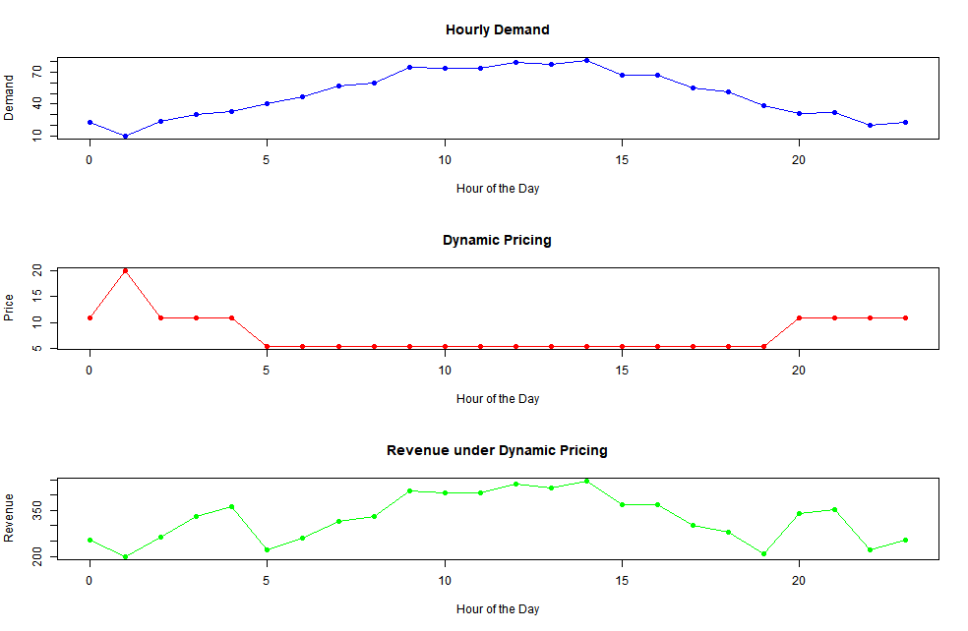
Third-Degree Price Discrimination
(dividing consumers into distinct groups)
This simulation, where the rental price of urban scooters adjusts based on congestion, illustrates the classic concept of congestion pricing, introduced by William Vickrey.
Originally proposed as a tool for managing public goods like roads, this idea is now widely adopted by private businesses. Companies dynamically adapt prices to fluctuations in demand, as seen in ride-sharing services, urban scooter rentals, and even ticket pricing for events.
Higher prices during peak demand optimize resource allocation and maximize revenue, while lower prices during off-peak hours encourage usage. This shift highlights how a concept rooted in public policy has been successfully adapted for profit-driven models, demonstrating its efficiency.
ACE simulation: https://github.com/JakobKappenberger/ai-priced-parking

Slide 31
Two-Part Tariff Pricing Strategy
A two-part tariff is a pricing strategy that divides the total cost (of puchse) of a product or service into two components:
A fixed fee (subscription or membership): This fee is charged upfront, regardless of usage, often to cover fixed costs or provide access to a service.
A variable usage fee: This fee depends on the quantity of the service or product consumed (e.g., per unit price).
This strategy is widely used in industries such as telecommunications, gyms, utilities, and amusement parks.
In the two-part tariff, the subscription fee primarily extracts consumer surplus, while the usage fee recovers production costs. This strategy is highly effective in markets with varied consumer preferences, allowing firms to optimize revenue across user groups.
P
cena
subscription fee primarily extracts consumer surplus
Popyt
KOSZTY
Q
ilość
the usage fee recovers production costs ~ MC

Slide 32
Two-Part Tariff Pricing Strategy
A fascinating connection exists between two-part tariffs and third-degree price discrimination. Pricing schemes can be designed such that a group with relatively low or elastic demand pays a low subscription fee but faces high usage charges, while another group with high or inelastic demand pays a high subscription fee and nearly zero usage charges. The very structure of these tariffs creates a self-selection mechanism, where consumers naturally choose the option that best aligns with their preferences and usage patterns.
On the graph, the left panel illustrates the high subscription fee combined with low usage charges, capturing most of the consumer surplus upfront. The right panel shows the opposite approach—low subscription fees with high usage charges—aimed at consumers who are more sensitive to upfront costs but willing to pay more per unit. This combination effectively segments the market while ensuring cost recovery and profitability.
the high subscription fee combined with low usage charges
P
subscription fee
low subscription fees with high usage charges
subscription fee
usage charges
MC
usage charges
q

Slide 33
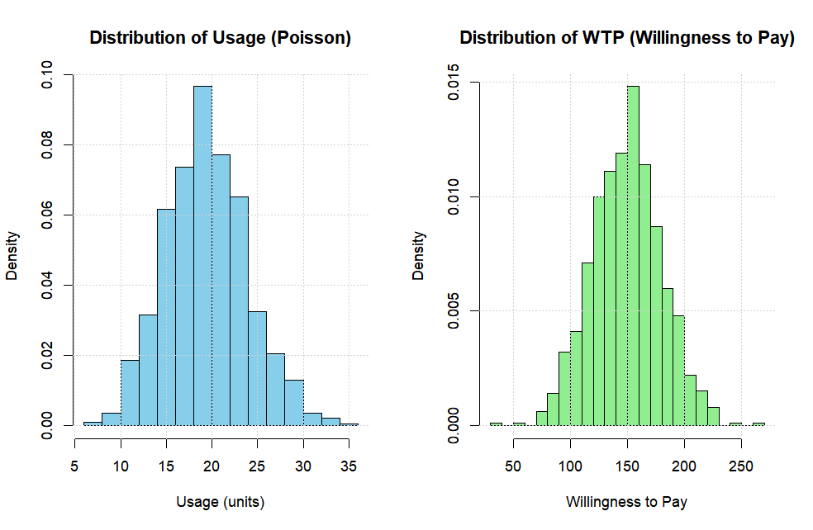
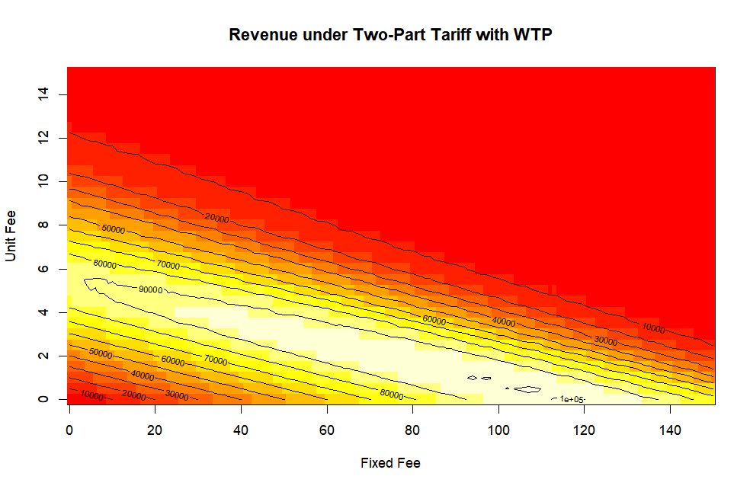
Two-Part Tariff Pricing Strategy
This example simulates a two-part tariff pricing strategy for a hypothetical company with 1,000 customers. The goal is to explore how different combinations of fixed fees and unit fees maximize revenue, given customer usage patterns and willingness to pay (WTP).
Customer Usage: is modeled using a Poisson distribution with an average of 20 units per customer. The histogram shows the distribution of customer usage, highlighting that most customers consume around 20 units, with a small number of heavy users.
Willingness to Pay (WTP) is modeled using a normal distribution with a mean of 150 and a standard deviation of 30. The histogram of WTP illustrates the range of prices customers are willing to pay, centering around $150.

Slide 34
Two-Part Tariff Pricing Strategy
Subscriptions have become a widespread pricing model, extending to products like Thermomix, photography equipment, and software, sparking significant controversies. Thermomix, once a one-time purchase, now charges subscription fees for recipe access and software updates, creating dependency on recurring payments for full functionality. In photography, advanced features, cloud storage, or firmware updates for cameras are increasingly locked behind subscriptions, frustrating users who feel forced to pay repeatedly for tools they already own.
In software, giants like Adobe and Microsoft have shifted entirely to subscription models, offering benefits like regular updates and cloud access. However, this approach often costs long-term users more than perpetual licenses, with the added risk of losing access to their tools or files if payments stop. The loss of ownership, recurring charges for basic features, and customer lock-in have led to growing dissatisfaction, as users feel exploited by business models that prioritize recurring revenue over consumer choice.
https://www.washingtonpost.com/business/2025/01/18/snoo-bassinet-subscriptions/
https://www.forbes.com/sites/nathanpettijohn/2024/05/07/the-recurring-problems-with-subscription-services/

Slide 35
Bundling?
Bundling is a monopolistic price strategy to sell two or more goods together as one product.
Economists by constructing this model are trying to answer the question:
It is good or bad practice for economy?
Is this practice hurting consumers?
  Should we stop this practice ???

Slide 36
A bit of history of economic thought
Example 1: Cournot effect. Should cupper and zinc be produced separately in two smelters or only in one smelter should produce this two metals and their mixture - brass.
Pros: The scope economics – monopolist is able to produce cheaper these two metal in one factory
Cons: Monopolist can create price strategy which can hurt consumers
Example 2: Stigler examined the antitrust law in which the is no possibility to sell films as a bundle (Block-Booking)

Slide 37
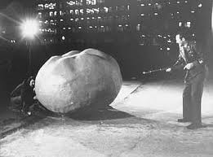
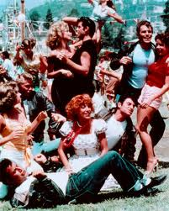
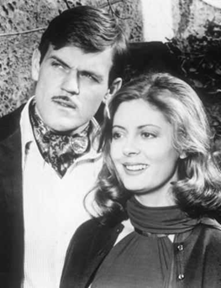
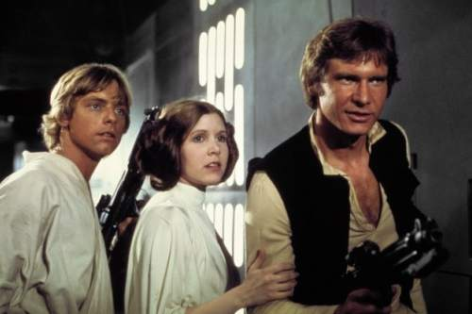
Bundling of films
(textbook example of films distributed in 1977)
The Other Side of Midnight
Star Wars
What was the title of „Little movie” in 1976?
Question: Which film was the „Blockbuster” for 20th Century Fox in 1976?
Notes:
Sektor IT – próba połączenia pracy doktorskiej z katedralnym projektem badawczym na temat pomiaru efektów sieciowych

Slide 38
Bundling of films
Expected value of films for the „typical” cinema owners.
 | „Blockbuster” | „Little movie” | Bundle
Cinema A | 70 | 35 | 90
Cinema B | 40 | 65 | 90
 | (2*40)=80 | (2*35) =70 | 150/180
If the cinema owners’ valuation of the films are negatively correlated
then cinemas and film distributors are gaining.
Notes:
Sektor IT – próba połączenia pracy doktorskiej z katedralnym projektem badawczym na temat pomiaru efektów sieciowych

Slide 39

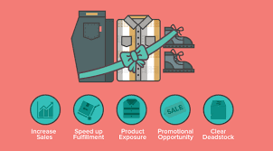
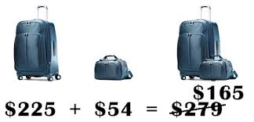

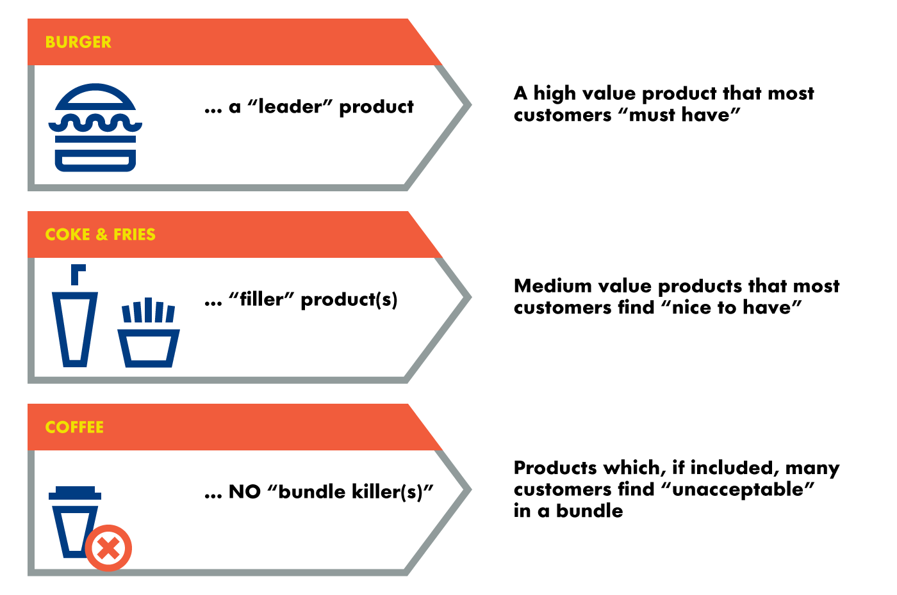
NOW – bundles are everywhere

Slide 40
Formal model of bundling (1)
Adams and Yellen (1976) presented more formal analysis
of the problem
Monopolistic firm
produces two goods x₁, x₂
marginal cost of production is c₁ = c₂,
no economies of scale and scope /cost of bundle equals sum of separate costs c_{b} = c₁ + c₂
Consumers
want to buy only one unit of good x1 and x2, marginal utility of a second unit of each good = 0
goods x1, x2 are neither substitutes or complements to each other / reservation price of bundle equals sum of separate reservation prices r_{b} = r₁ + r₂
Notes:
Sektor IT – próba połączenia pracy doktorskiej z katedralnym projektem badawczym na temat pomiaru efektów sieciowych

Slide 41
Formal model of bundling (2)
The firm can apply three pricing strategies sale of these two goods:
r₂
Pure Bundle
Firm sells
only the bundle
at a price p_{b}
p_{b}
Bundle is purchased
r_{b} = r₁ + r₂ >= pb
Nothing is purchased
p_{b}
r₁
Notes:
Sektor IT – próba połączenia pracy doktorskiej z katedralnym projektem badawczym na temat pomiaru efektów sieciowych

Slide 42
Formal model of bundling (3)
r₂
x₁ and x₂ are purchased sepratly
r₁ >= p₁
and r1 >= p1
Only x2 is purchased
r2 >= p2 and
r1 < p1
Pure Components
Firm sells goods
separately
at their separate prices
p₂
Nothing is purchased
Only x1 is purchased
r1 >= p1 and r2 < p2
p₁*
r₁
Notes:
Sektor IT – próba połączenia pracy doktorskiej z katedralnym projektem badawczym na temat pomiaru efektów sieciowych

Slide 43
Formal model of bundling (4)
r₂
x2 is purchased
Mixed Bundling
Firm sells good
separately
or as a bundle
x₁ and x₂ are purchased (as bundle)
p₂
Nothing is purchased
x1 is purchased
p₁
r₁
Notes:
Sektor IT – próba połączenia pracy doktorskiej z katedralnym projektem badawczym na temat pomiaru efektów sieciowych

Slide 44
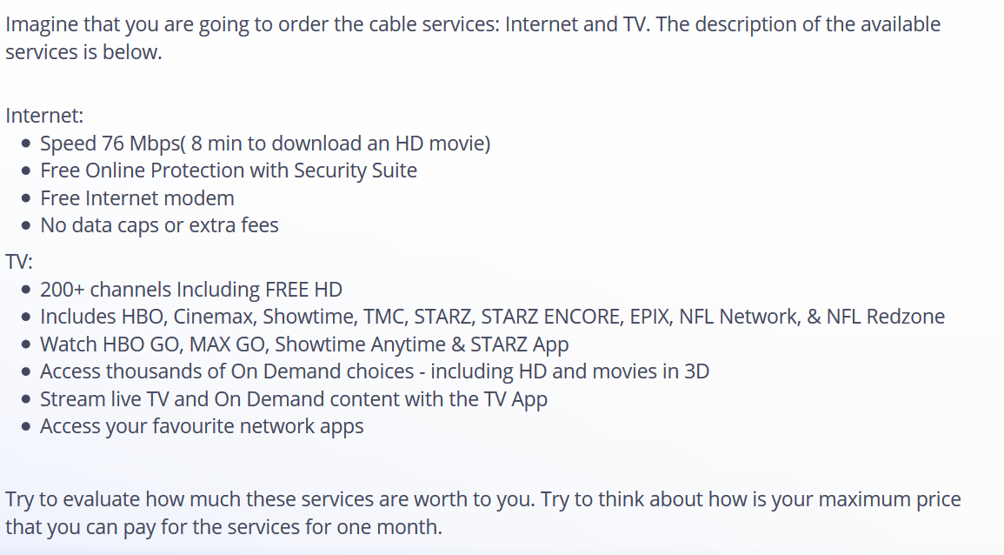
Ad hock research

Slide 45
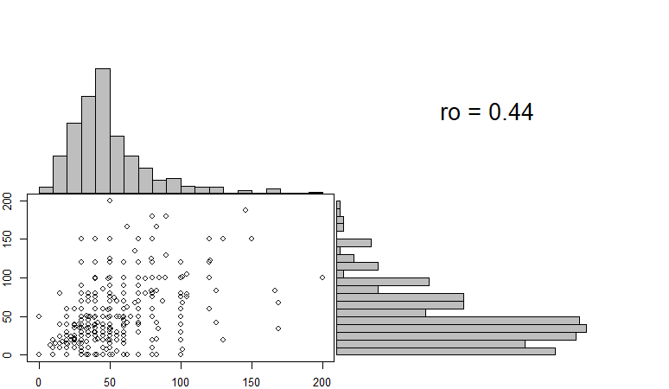
Ad hock research

Slide 46
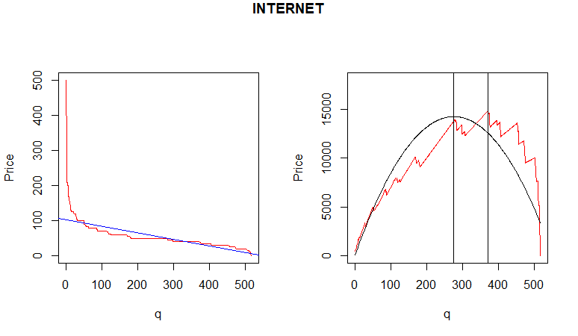
Ad hock research
> summary(dane_cable$p_INT)
Min. 1st Qu. Median Mean 3rd Qu. Max.
0.00 35.00 50.00 57.05 60.00 1249.11

Slide 47
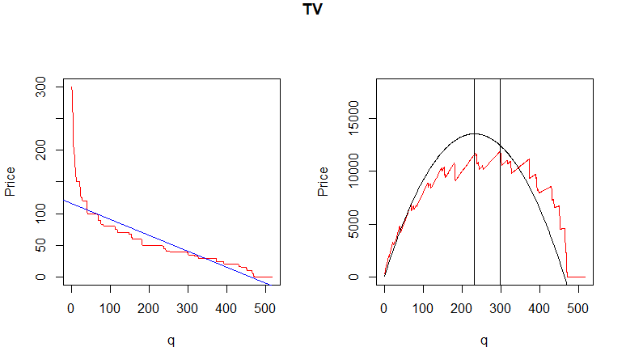
Ad hock research
> summary(dane_cable$p_TV)
Min. 1st Qu. Median Mean 3rd Qu. Max.
0.00 25.00 40.00 62.07 70.00 3442.50

Slide 48
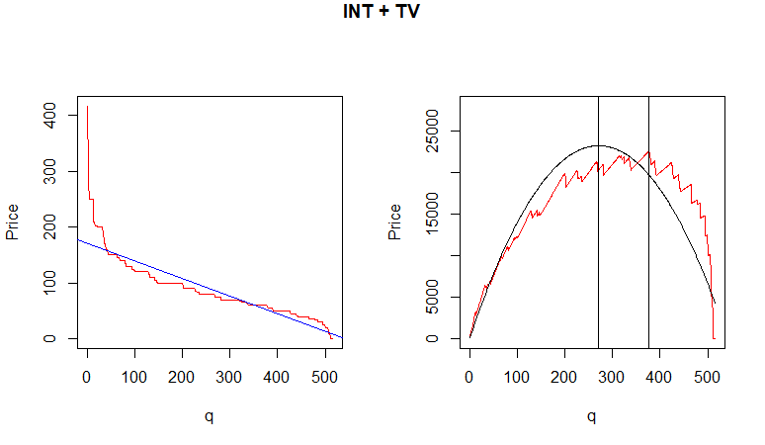
Ad hock research
> summary(dane_cable$p_INT_TV)
Min. 1st Qu. Median Mean 3rd Qu. Max.
0.00 55.00 80.00 95.84 120.00 2165.12

Slide 49
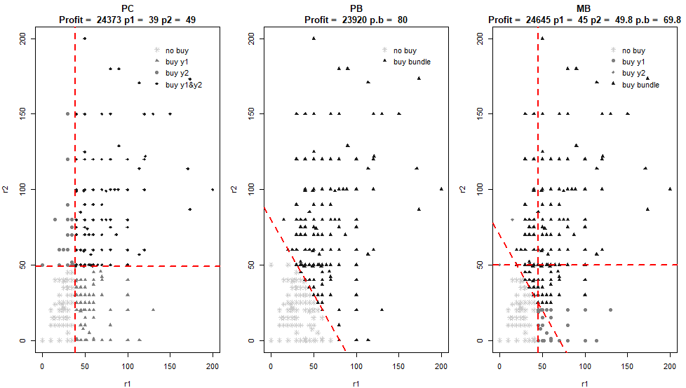
Ad hock research

Slide 50
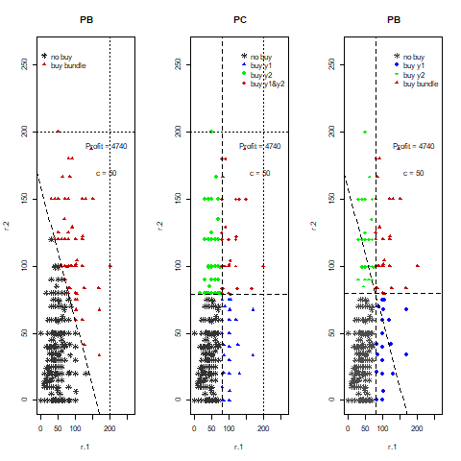
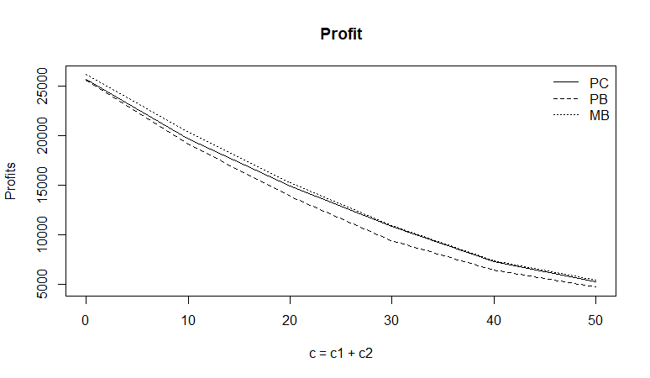
Unbundling /cost
Single-item (pure components) sales become more profitable than bundling when marginal and average costs are high relative to consumer valuations.
In such cases, the cost of producing or selling an additional unit is significant, reducing the incentives for bundling, as the economies of scale do not offset these costs effectively. Firms can instead maximize profits by selling items individually, pricing each closer to the consumer's willingness to pay.
This approach is particularly suited to markets with high production costs or significant heterogeneity in consumer preferences, where bundling fails to capture the maximum consumer surplus. It is increasingly prevalent in digital goods and services, where personalization and dynamic pricing enable firms to optimize revenue by targeting individual consumers.
Notes:
Sektor IT – próba połączenia pracy doktorskiej z katedralnym projektem badawczym na temat pomiaru efektów sieciowych

Slide 51
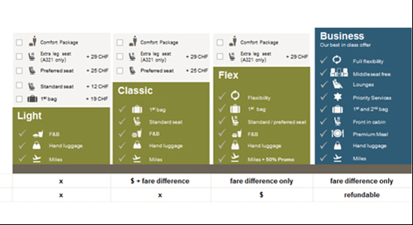
Airlines – unbundling 2008
An example of this shift is seen in the airline industry after 2008, where unbundling practices became widespread. Airlines began charging separately for services that were traditionally included in the ticket price—such as checked baggage, in-flight meals, and seat selection—allowing them to generate additional revenue by tailoring prices to individual customers’ willingness to pay.

Slide 52
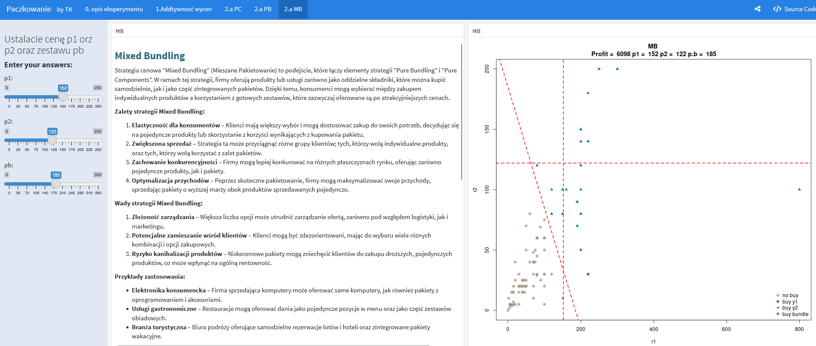
Airlines – unbundling 2008
Draft of the report based on the pen experiment :/ https://microeconomics.shinyapps.io/bundling_03_PL/#section-a-pc

